Slide 1
SWE 1010 PROJECT REVIEW-2 Recognition of Hand Movement for a Paralytic Person Using Convolutional Neural Network
MEMBERS:
P. Nageswararao (20MIS1006)
M. Srikanth (20MIS1086)
ch. jaya Venkatesh (20mis1083)
FACULTY:
PROF. Geetha s

Slide 2
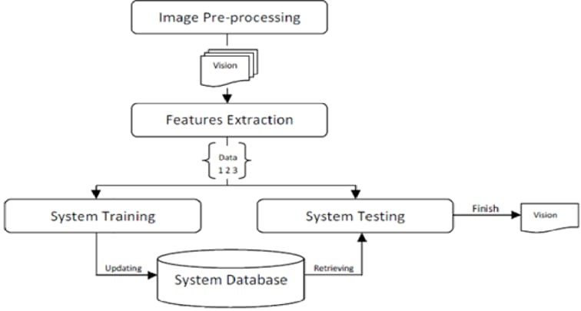
EXISTING SYSTEM

Slide 3
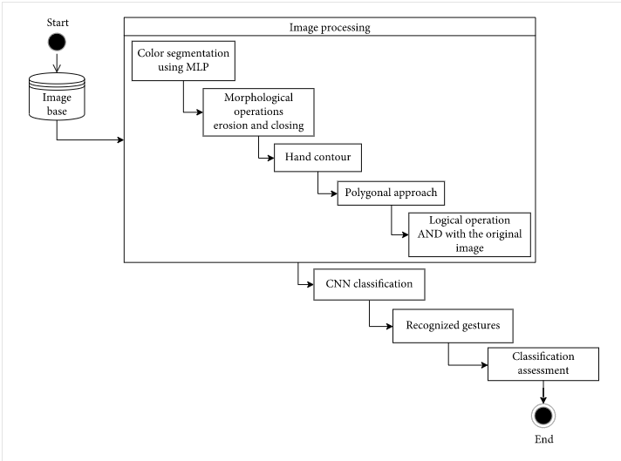
PROPOSED SYSTEM

Slide 4
EXPLANATION IN DETAIL
One of the problems in gesture recognition is dealing with the image background and the noise often present in the regions of interest, such as the hand region. The use of neural networks for color segmentation, followed by morphological operations and a polygonal approximation, presented excellent results as a way to separate the hand region from the background and to remove noise. This step is important because it removes image objects that are not relevant to the classification method, allowing the convolutional neural network to extract the most relevant gesture features through their convolution and pooling layers and, therefore, to increase network accuracy. The proposal to make a logical AND operation with the segmentation masks and the original images provided the relevant information of the palms and fingers. Thus, the proposed CNN architectures achieved high success rates at a relatively low computational cost. It was superior to methodologies mentioned in related works, confirming the robustness of the presented method. In addition, the proposed architectures reached accuracies very similar to the architectures already defined in the literature, although they are much simpler and have a lower computational cost. This is possible due to the proposed image processing methodology, in which unnecessary information is removed, allowing improved feature extraction by the CNN. The proposed methodology and CNN architecture open the door to a future implementation of gesture recognition in embedded devices with hardware limitations. The proposed methodology approaches only cases of gestures present in static images, without hand detection and tracking or cases of hand occlusion. In the future, we intend to work on these particular cases in a new data preprocessing methodology, investigating other techniques of color segmentation and deep learning architectures.

Slide 5
SYSTEM REQUIREMENTS
Hardware
• Web Camera - (320 x 260 minimum)
• Processor - 400 MHz or above
• RAM - 512 MB or above
• Hard disk - at least 256 MB free
Software
• Operating System Platform - Windows XP
• Back End – C++ or Python
• GUI development - Visual Basic 6.0 Gesture Recognition

Slide 6
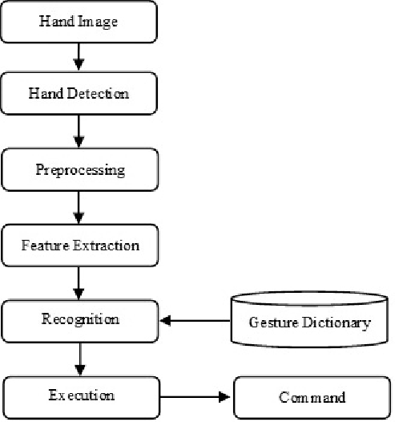
DATA FLOW DIAGRAMS DFD LEVEL 1

Slide 7
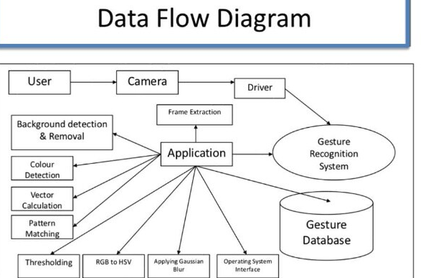
DFD Diagram LEVEL 2

Slide 8
DATA DICTIONARY
High Resolution Camera
The images of the hand movement are gathering from High resolution camera. This image is in RGB form. Color transformation structure for the RGB image is created, and then, RGB form image will be convert into grayscale format.
Data Pre-processing
It is step in which the data gets transformed, or Encoded ,to bring it to such a state that now the machine can easily parse it i.e.Hand tracking and color will be detected. Image is extract done using the smoothing filter. Image enhancement is carried out for increasing the contrast.
Convolution Neural Network
We propose a convolution neural network method to recognize hand movements of human task activities from a camera image. To achieve the robustness performance , the skin model and the calibration of hand positon and orientation are applied to obtain the training and testing data for the CNN .
Feature Extraction
Feature extraction plays an important role for identification of an Hand signals. In many application of image processing feature extraction is used. Color, texture, morphology, edges etc. This is the feature which can be used in Recognition of hand movement.

Slide 9
THANK YOU

